Slide 1
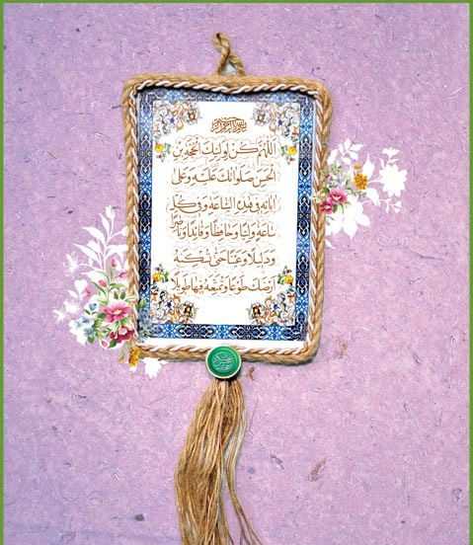
Becoming a perfect human being
انسان کامل و رسیدن به کمال
Lesson 5
Self-Building
خودسازی

Slide 2
Self-Building (خودسازی)
5 Stages:
Avoid unlawful acts(محرّمات)
Perform Obligations (اداء الواجبات)
Avoid Non-Recommended and non-rewardeble Actions (مکروهات و شبهات مباهات)
Perform Recommended acts (مستحبات)
Perform Moral acts (مکارم الاخلاق و محاسن الاخلاق)
Notes:
Non-rewardeble,

Slide 3
Self-Building (خودسازی)
Action Items:
1. Recognition of duties (شناخت و معرفت)
    Rituals of worship (احکام تعبّدیات)
    (The only way is to use the Risalah of your Mujtahid)
    Non-religious Rituals (احکام غیر تعبّدیات)
    (A’ql, Qur’an, Hadith, Islamic Books, Law of the Land, experience, traditions, etc…)
    Etiquette, ethics and morals (اخلاق)
    (Books of Akhlaq), visits to graveyard, spending time with wise person.

